Slide 1
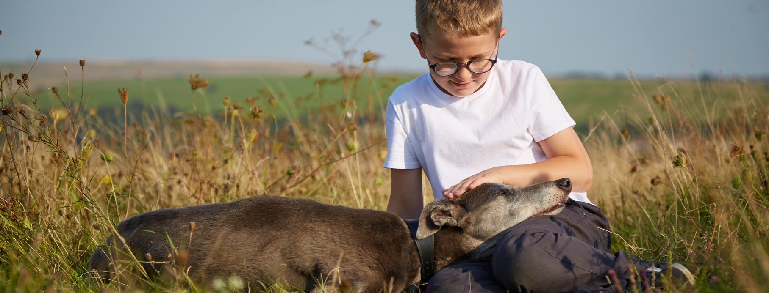
Looking after pets takes time
ALL pets need looking after
EVERY DAY
Sometimes, people get a pet without thinking about how much time they need to spend looking after it every day.
Starter:
Choose a pet and research all the things someone who was looking after that pet would need to do.
Notes:
Starter
Explain to the class that all pets need looking after every day. Point out that many people get a pet without thinking about how much time they need to spend looking after it every day.
Choose a particular pet and ask pairs of pupils to research all the things someone who was looking after the pet would need to do.
As a class, discuss this, is it easy to look after a pet? Are some pet’s easier to look after than others?

Slide 2
Pet Care Diary
TASK 1: Write a diary of what has to be done every day to look after a pet. Don’t forget to include specific times for each task
Example:
9am - Feed the dog
TASK 2: How much time would the pet owner have to spend everyday looking after the animal?
TASK 3: What advice would you give to someone who was thinking of looking after the animal?
Notes:
Pet Care Diary - How much time?
After the pupils have researched what someone who has a pet needs to do, ask them to make a diary of what has to be done every day with specific times for each task.
When the diaries are finished, ask the pupils to estimate how much time the pet owner would have to spend every day looking after the animal.
What advice would they give someone who was thinking of looking after the animal?

Slide 3
Pretend Pet
Question: Is a classroom a good place for a pet?
Why?
Points to think about:
- Extra responsibility on top of an already busy school day?
- Who is responsible for the pet?
- Who will pay for the food and vet bills?
- Who will care for the animal in the evenings, at weekends and during the holidays?
TASK 4: As a class, we must decide on a ‘pretend’ pet that we will all look after.
Decide on a name.
Introduce the pet to the class.
TASK 5: Write a pet diary about looking after this animal.
What time will they need to be fed? Walked? Watered?
Cleaned? Socialised with? Who is responsible for them at
weekends and evenings?
Notes:
Pretend pet
A pretend pet can be an excellent focus for developing responsibility and care toward animals.
Ask pupils why they think the classroom is not an ideal environment for a pet.
Please note: the RSPCA does not believe live animals should be kept in the classroom.
Here are some things to think about:
It is an extra responsibility on top of an already busy school day.
Who is responsible for the pet?
Who will pay for the food and veterinary bills?
Who will care for the animal in the evenings, at weekends and during the holiday?
Once the class has decided on a pretend pet, ask the pupils to think of all the things it needs and give it a name.
Ask the class to write a pet diary about looking after the animal. They should think about who is going to look after the animal at weekends and evenings.
Differentiation: Discuss that some children have allergic reactions to animals.
Zoonotic diseases: infections passed from animals to humans, can be dangerous. Animals also bite! You should carry out a full risk assessment before anyone brings an animal into the classroom.

Slide 4
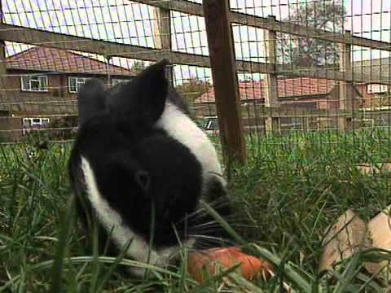
What do pets need video
Notes:
Invite them to write a pet care rota so that individuals or pairs of pupils can look after the pet for 24 hours.
Idea: You could make the pet the class mascot and use it in other work.

Slide 5
Plenary & Summary
Class Discussion:
Let’s talk about the good things and the difficult things about looking after our classroom pet.
What is difficult?
What is easy?
Has it made you feel differently about getting a pet of your own?
If you already have a pet, has it made you feel different about your responsibilities?
What advice would you give other people who are thinking of getting a pet?
Explain one thing you have learnt today.
Homework
Can you find out how much it would cost to look after our classroom ‘pretend’ pet? Are you surprised by the cost?
Notes:
Class discussion
Encourage the pupils to talk about the good things and the difficult things about looking after the pretend pet.
What was difficult?
What was easy?
Has it made them feel differently about getting a pet of their own?
Or if they already have a pet, has it made them feel different about their responsibilities? What advice would they give people who are thinking of getting a pet?
Homework - can they find out how much all the things cost to look after a pet? Are they surprised by the cost?

